Slide 2

HOTEL INFINITY
Prepared By –
JAY DESAI (17CE025)
NIMESH ITALIYA(17CE036)

Slide 3
MAIN ASPECTS
Log-In
MENU CARD WITH IMAGES
GAME
SONGS
DIALOGUES
BILL

Slide 4
Concepts ARE USED:::
Class and Objects
Virtual Functions
Multifile Programs
Polymorphism
Function Overloading
Inheritance
Default Arguments

Slide 5
FEATURES
First Of all It is mandatory to create an account / Log - in in our Hotel just for Security Purpose.
We assure You about Our Food Quality and also Services Provided By Us.
Our Hotel is First Ever Hotel in India In which You can not only Listen A Song But also Listens Dialogues contains Patriotism about INDIA.
You can also Play Ludo with LUCK Game If You are not interested in Songs/Dialogues.
But One Key Feature is about Billing.
You think what is special in Bill So Answer is in Next Slide.

Slide 6
INSPIRATION
Many Hotels Have Great services with Testy Food But The Biggest Limitation is whenever We order our food then We have to wait until food will arrive.
So , We remove this bias By including Entertainment Factor Between Ordered Food and Served Food.
Idea Of This Kind Of Hotel is come out from A movie’s Post Credit Scene named Avengers (2012) when Iron man told his teammates for do something entertaining till we got food.
So , This Hotel is based on this IDEA…

Slide 7
And Surprise is…
All Customers will get some special discount just Because they are going to be a part of Tremendous and Fantastic Journey with Us.
We all are very excited about the new journey which will be started from you.

Slide 8
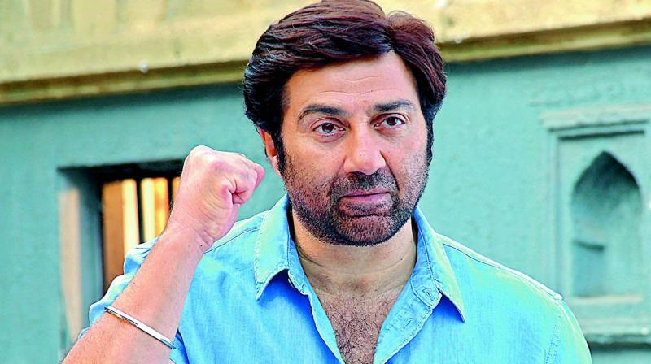
If We Talk about Dialogues regarding Patriotism then first name should be Sunny Deol.

Slide 9
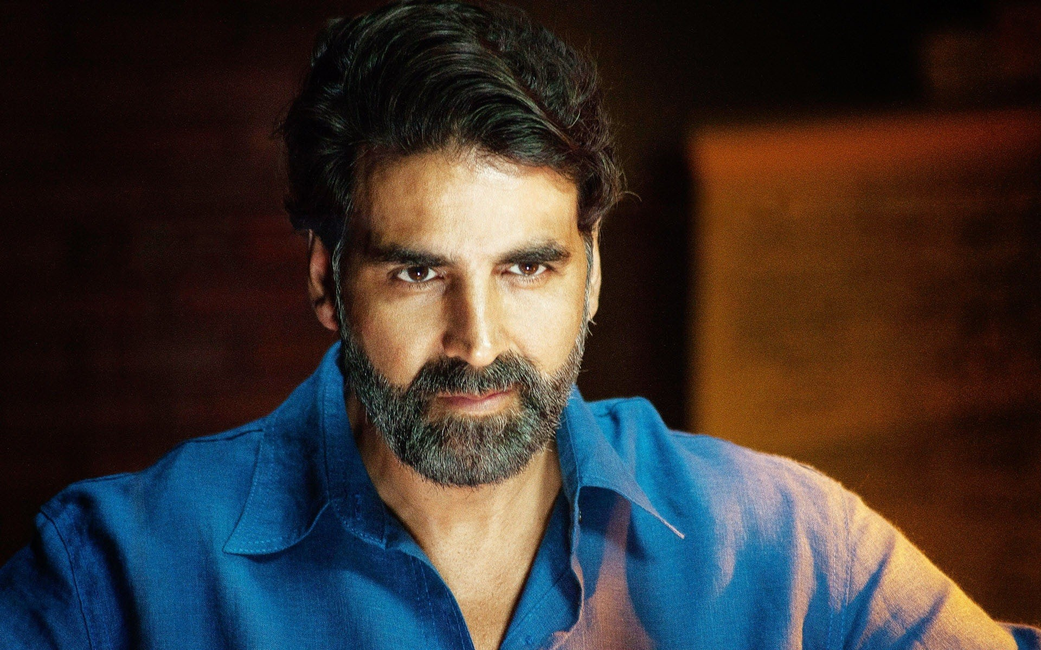
Second actor who Spread Social Awareness in Our Country through his movies , is Akshay Kumar.

Slide 10
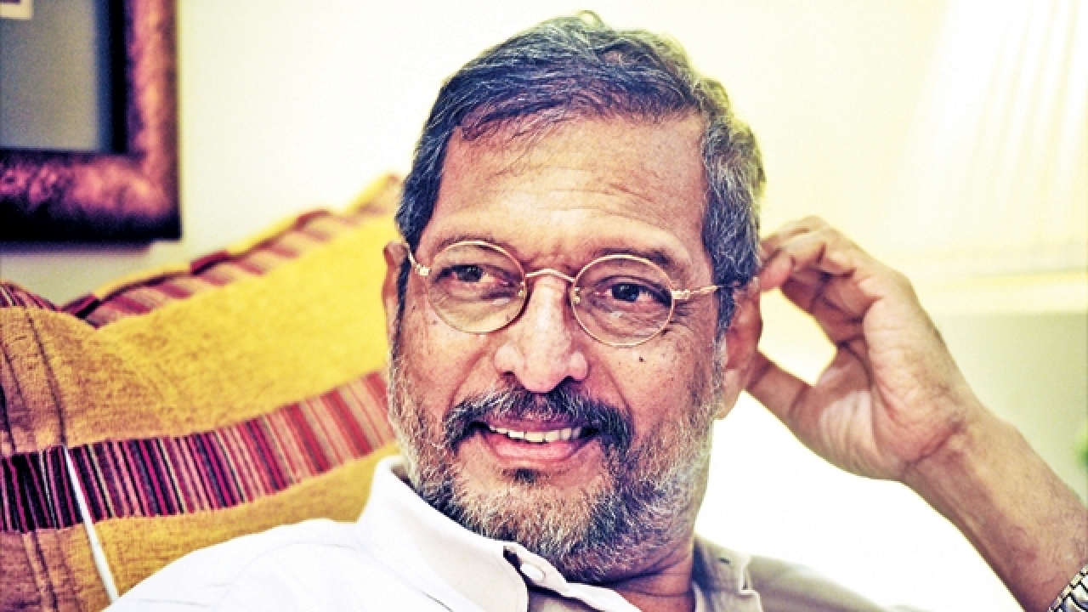
And Third One is Nana Patekar

Slide 11
LUDO WITH LUCK GAME
You are quite familiar with LUDO Game and there is no more changes in basics of this game and Also We provide Rules Before playing So You can easily play this game.
But You think that what about “WITH LUCK “ , So you have to wait until Our Hotel will be ready for serve.
And also We include something more for you in game , So just wait and watch.

Slide 12

SONGS
We choose random Songs for you according to trending and demanding of songs over long period of time.

Slide 13
But this all things are not Important or have 1st priority in Hotel So You think that what happens.
But this is just trailer and Heart Of Our Project means about food and menu and many other things are introduces you directly at opening of our hotel.
If You want to know about this hotel in detail then Be calm until inauguration Of Hotel is done by Our Respective and Honourable Faculties Mr. Anirudh Sir and Mr. Ronak Sir.

Slide 14
DRAWBACKS
Our Hotel is Purely Vegetarian.
We can only provide 80 Bollywood songs.

Slide 15

WORLD PREMIERE ON 2nd APRIL

Slide 16
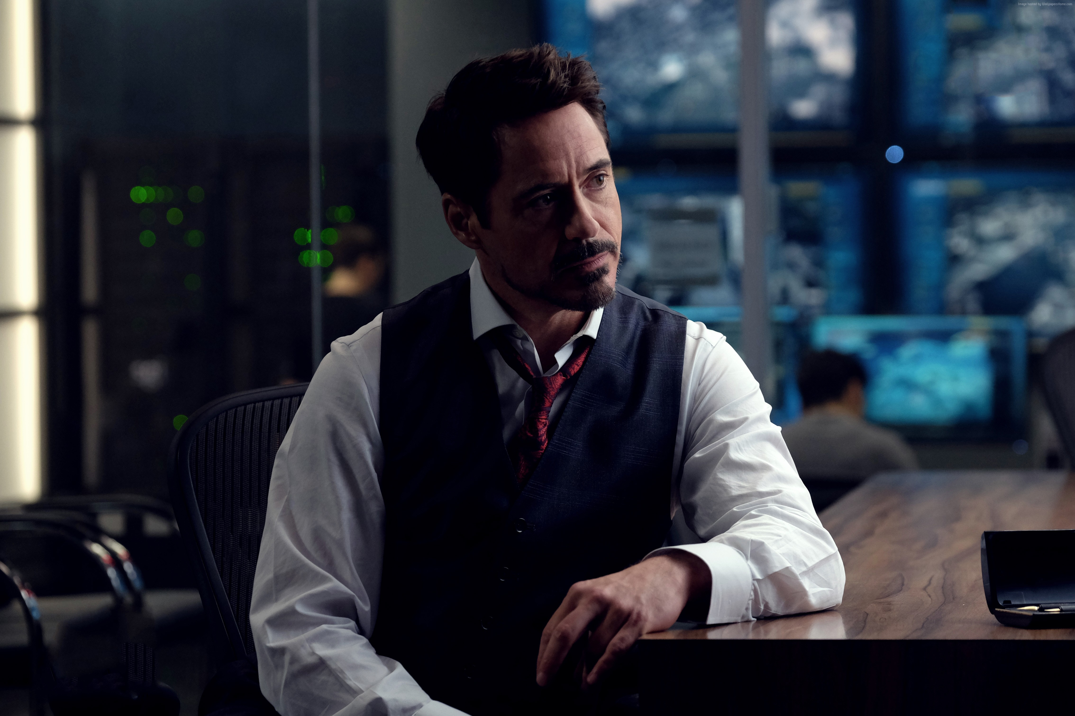
SPECIAL THANKS TO
Robert Downey Jr.

Slide 17
THANK YOU

